Slide 1

ANALYSIS OF HEALTH FACILITIES IN NAIROBI

Slide 2

ABOUT THE PROJECT
The purpose of this analysis is to come up with healthcare solutions specific for the county of Nairobi that align with Sustainable Development Goal (SDG) 3 for Universal Health
The data used for this analysis is population data from https://africaopendata.org/dataset/2019-kenya-population-and-housing-census and health facilities data from https://africaopendata.org/dataset/health-facilities-in-kenya
Meaning of columns
- (ART) is an abbreviation for antiretroviral therapy, which is a medical treatment for people infected with HIV.
- (C-IMCI) stands for Community-based Integrated Management of Childhood Illnesses, that focuses on the health and well-being of the child. CIMCI aims to reduce preventable mortality, minimize illness and disability and promote healthy growth and development of children under five years of age.
- (FP) Family Practitioner gives personal, primary, and continuing care to individuals irrespective of age, sex, or illness.
- (IPD) is an abbreviation for In-patient department, which is a medical facility within a hospital or healthcare center where individuals are admitted for medical treatment or surgery to manage complex medical conditions, diseases, or illnesses.

Slide 3

ANALYSIS SETBACKS
Quite a number of columns did not have any information.
The job title column contained numerous missing data points, and the null values were left unfilled due to the sensitivity of the information.
There was a discrepancy between the constituencies in the population and health facilities data frames: the health facilities data frame did not include Njiru constituency, and the population data frame did not include Ruaraka.
JOAN NJOROGE

Slide 4
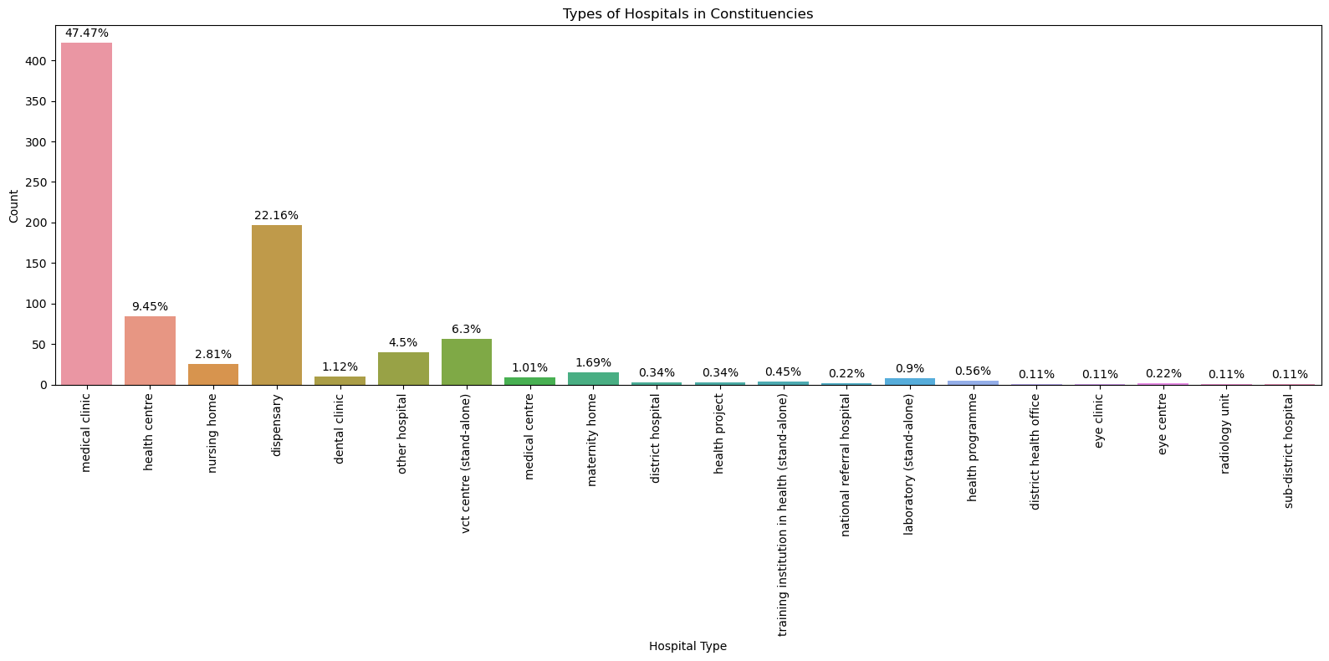
Distribution of Health Facilities
Medical clinics are the most common types of medical facilities in Nairobi accounting for 47.47% of the total number of facilities in the county followed by dispensaries at 22.16%.
Sub-districts hospitals, eye clinics, district health offices and radiology units are the least common health facilities with a percentage of 0.11%.
Maternity homes account for 1.69% of the total number of health facilities.
JOAN NJOROGE

Slide 5
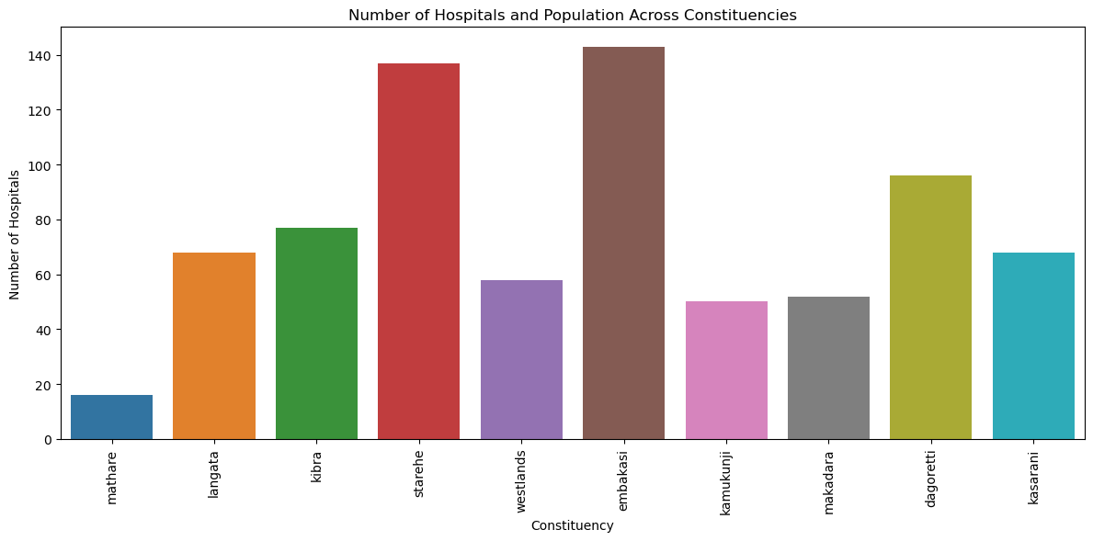
Hospitals and Constituencies
Embakasi with a population of 308,654 has the highest number of medical facilities (143) followed by starehe (134) with a population of 185,777.
Despite having the largest population of 988,808 , kamukunji has a very low number of medical facilities (50). Dagoretti on the other hand with the same population has 96 health facilities, which is still low.
Mathare with a population of (206,564) has the lowest distribution of medical facilities (16).
JOAN NJOROGE

Slide 6
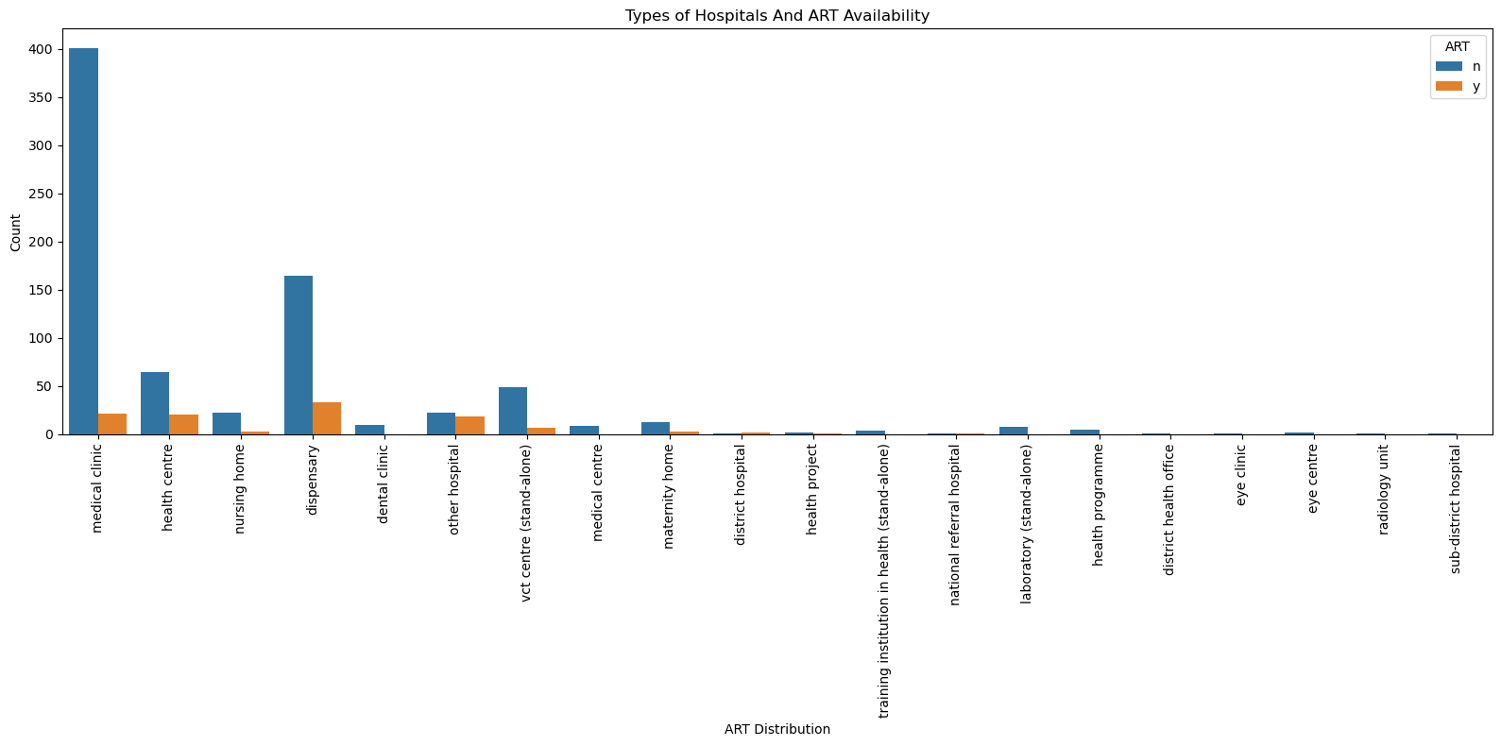
ART Distribution
67% of district hospitals offer ART services.
Only 23% of health centers offer ART services
No medical center offers ART services.
Only 12% of Nursing Homes offer ART services.
Only 5% of Medical clinics, offer ART services.
- Only 20% of maternity homes offer ART services
JOAN NJOROGE

Slide 7
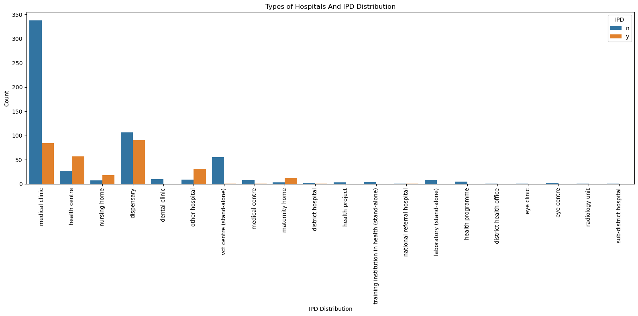
IPD Distribution
Health centers , other hospitals, nursing homes and maternity homes offer IPD services more frequently than they don’t
A significant percentage of medical clinics do not offer IPD services.
District health offices, eye clinics, eye centers and radiology units do not offer any IPD services which is in alignment with the nature of services they offer
JOAN NJOROGE

Slide 8

Other observations
Majority of the people in charge of the facilities are nursing officers in-charge, with a frequency of 294 constituting 33.07% of all positions.
Medical superintendent are the least officials in charge with a frequency of 25 constituting 2.81% of all positions.
Kenyatta National Hospital , one of 2 referral hospitals, has a bed capacity of 1455.
The only Radiology Unit is The Plaza X-Ray Services.
There are 25 nursing homes in Nairobi, accounting for 2.81% of the total health facilities.
VCT Centers account for 6.3% of the total healthcare facilities.
JOAN NJOROGE

Slide 9

Recommendations
Training programs and awareness campaigns for healthcare providers, about the importance of ART services in HIV/AIDS management.
Increase the number of healthcare facilities in highly populated areas to ensure better access to healthcare services for residents.
Provide incentives and support to facilities, to facilitate 24-hour care and weekend services, ensuring access of medical attention to individuals at any time
Invest in the infrastructure of healthcare facilities to support the delivery of C-IMCI services. This can help in promoting development among children under five years of age.
Facilities should consider offering inpatient services. This can act as short term care or temporary accommodation, ensuring quick intervention if necessary and prompt treatment of individuals within the same facility.
JOAN NJOROGE

Slide 10

Summary
In order to guarantee healthy lives and promote well-being for all people at all ages, the United Nations adopted Sustainable Development Goal 3.
Implementing these recommendations outlined such as expanding ART services, increasing bed capacity, and providing around-the-clock care, will bring Nairobi closer to achieving Sustainable Development Goal 3 for Universal Health Coverage and improve healthcare outcomes for the residents of Nairobi.
JOAN NJOROGE

